Slide 1
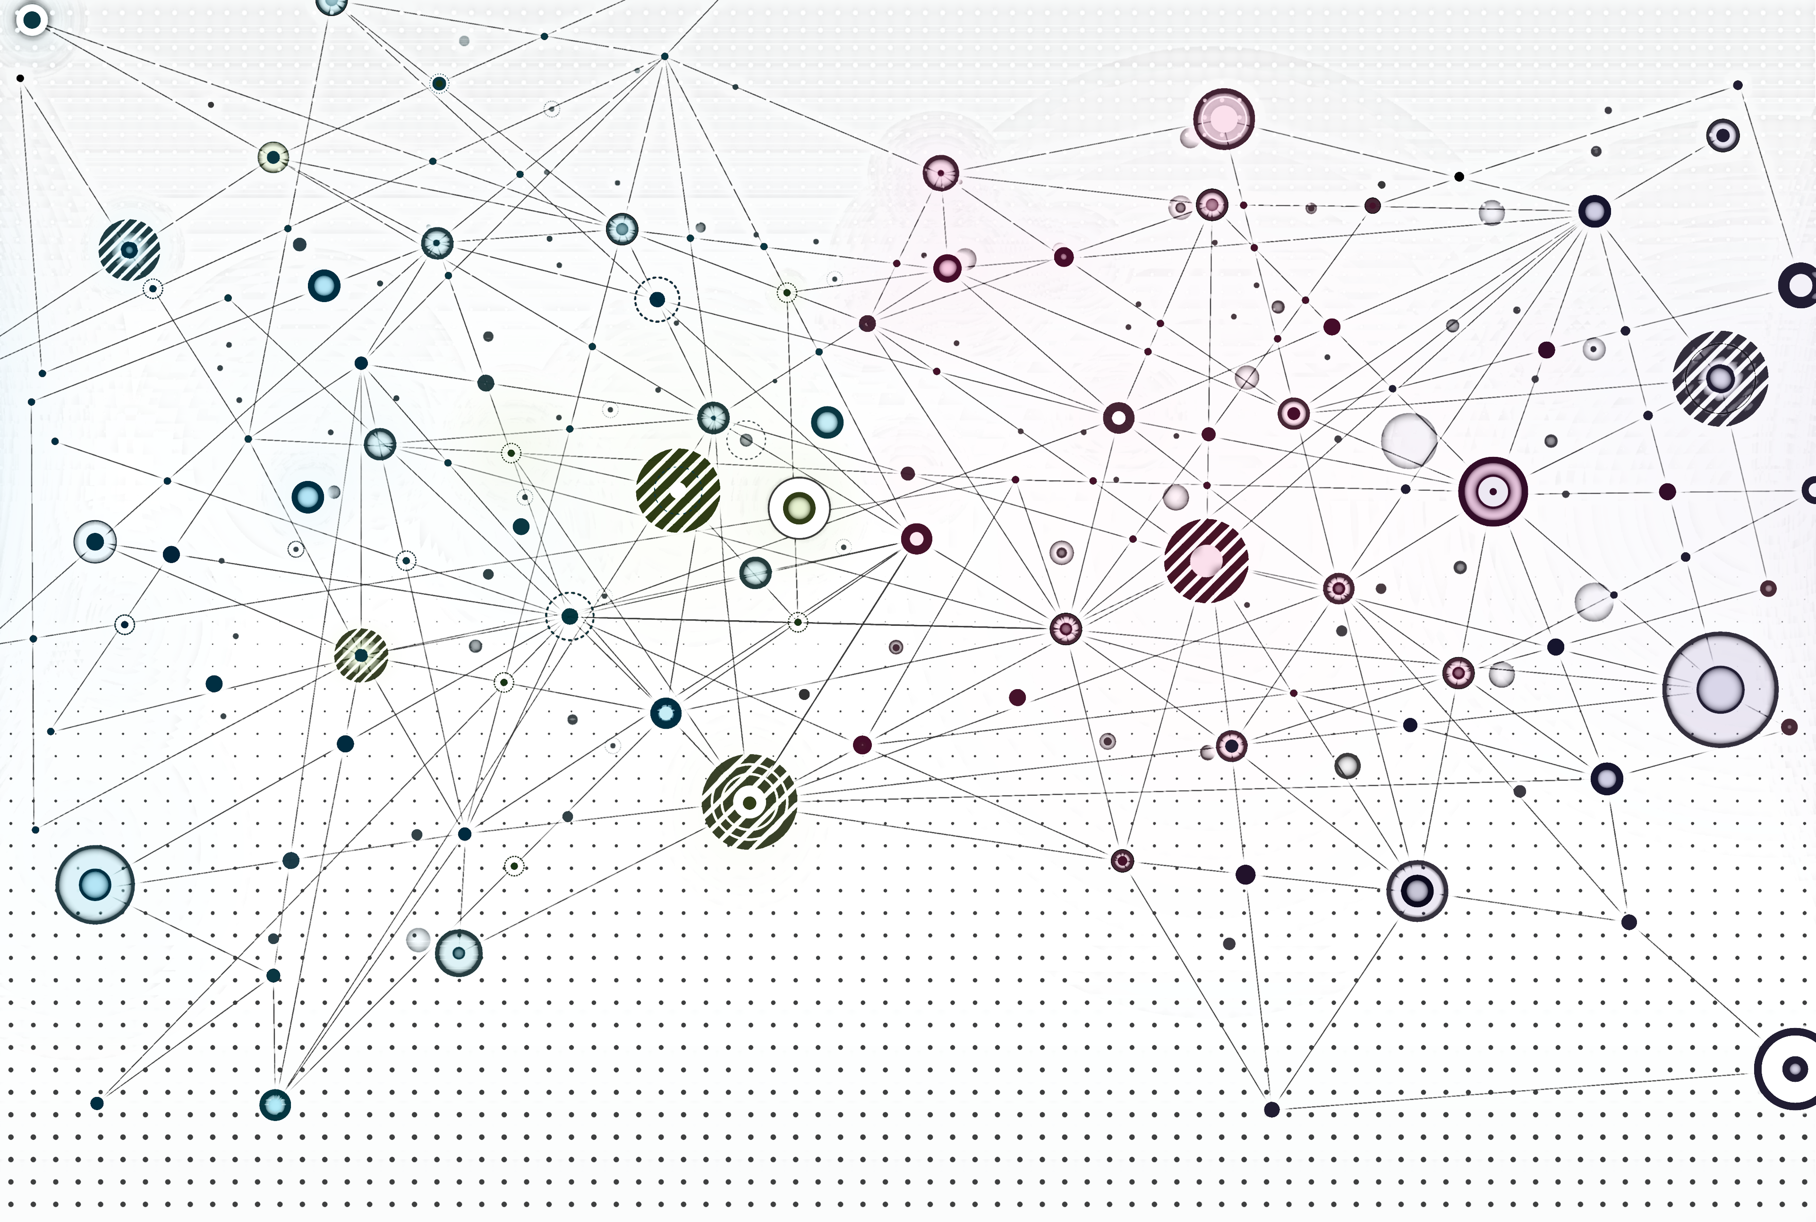
Introduction
Aaron J. Masino, PhD
Associate Professor of Computer Science

Slide 2
Overview
Course logistics
Motivations for graphs
Rationale for specialized methods
Terminology
Machine learning tasks on graphs

Slide 3
Course logistics

Slide 4
Syllabus Review

Slide 5
Course Project Review
READ ME!
Complete details on course project requirements are on Canvas:
ML4G-8810-Course-Project-Details.pdf

Slide 6
Course project
Goals
Gain experience with implementing and evaluating graph machine learning models on a project that is meaningful to you
Create a lasting resource for your technical profile - lab PIs and hiring managers love these
Three types of projects
Real-world application of graph neural networks (GNNs)
In-depth web-based tutorial on PyTorch Geometric (PyG) functionality
Implementation of new research in PyG
(Opt In) If you write a blog post for your project, I will add it to the course blog.

Slide 7
1. Real-world application research with GNNs
Goal: identify a use case of interest to you and demonstrate how GNNs can be applied
Portfolio Output
Blog post or final report, code files
Example applications
Predicting candidate drugs
Product recommendation
Internet traffic anomaly detection

Slide 8
2. PyG Tutorial
Goal: develop a web-based tutorial that provides an in-depth explanation of some existing PyG functionality
Portfolio Output
Blog post (required for this project type)
code files
Example tutorial topics (PyG docs include minimal tutorials for these, but they assume a lot of background knowledge)
PyG’s GraphGym
Multi-GPU Training

Slide 9
3. Research method implementation
Goal: implement a method from a recent (2025, preferably) research paper on machine learning for graphs
Portfolio Output
Final report or blog post
github repository & demonstration code files
(Extra credit) pull request to PyG contrib
Portfolio requirements
Implementation should include comprehensive testing and documentation
Build on existing PyG and PyTorch code where possible
Warning: This project type is only recommended if you are already familiar with PyG and PyTorch and if team of three members is committed to the project!

Slide 10
Course Project Review
READ ME!
Complete details on course project requirements are on Canvas:
ML4G-8810-Course-Project-Details.pdf

Slide 11
Overall course surveys
This is a new course and there will be room for improvement.
Surveys about the course will be released during the semester
Your feedback is incredibly valuable
I will keep them brief (2-3 questions)
Submissions are anonymous

Slide 12
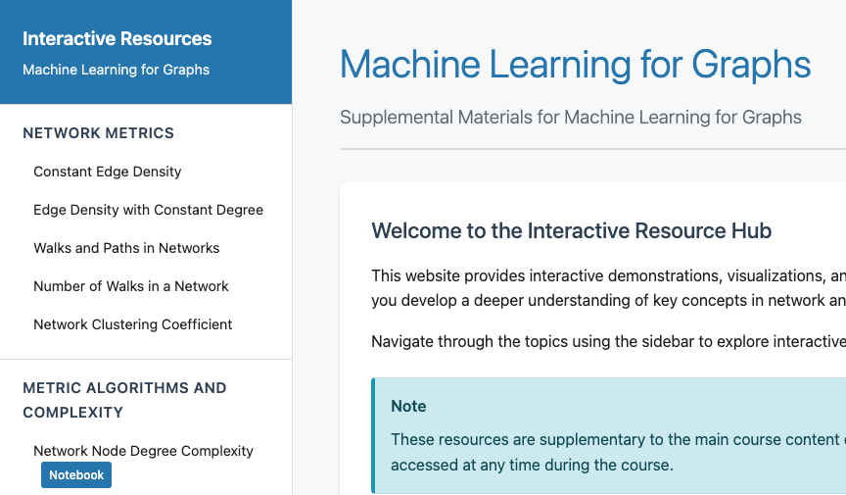
Supplemental course materials
Throughout the slides, there are links to supplementary materials
Materials include interactive web pages and Jupyter notebooks
Materials further illustrate concepts
Indicated by URL in a blue box:
https://ml4g.masinolab.com/index.html

Slide 13
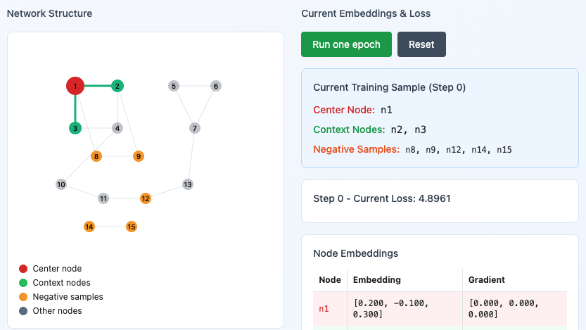
Supplemental materials an experiment with AI
The supplementary materials are all created with generative AI
Student perception of the quality and value of the materials is of interests (to me)
Surveys related to these materials will be released during the semester
They will be brief
Anonymous

Slide 14
Motivations for graphs

Slide 15
A language for entities and relationships
Graphs provide a general language for describing and analyzing entities and their relationships
Many complex systems and phenomena of interest have a natural graph representation

Slide 16
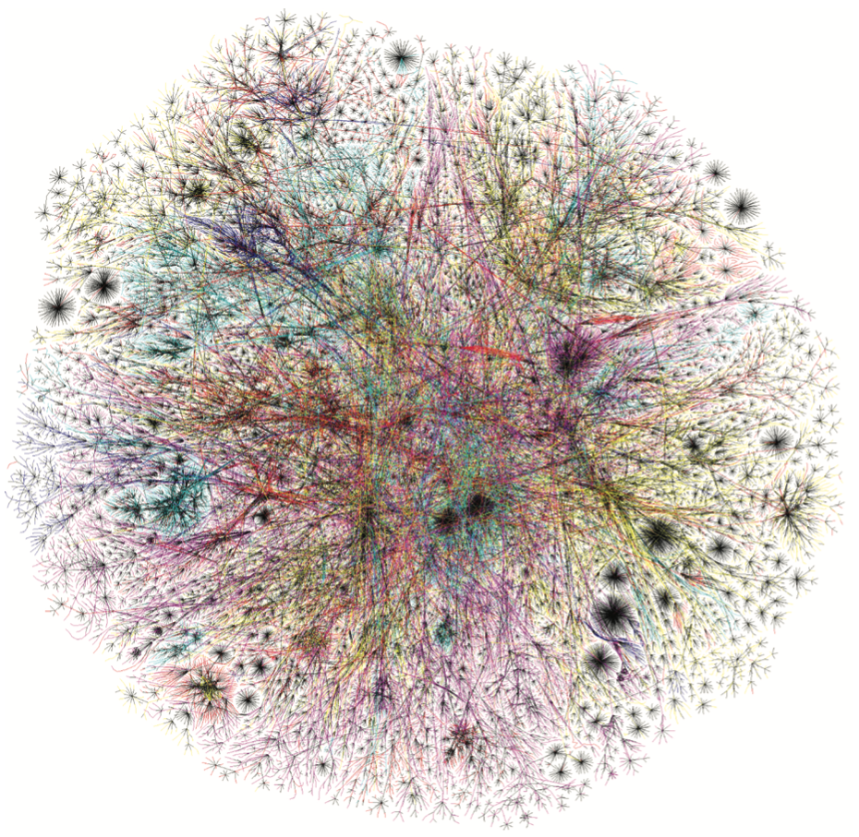
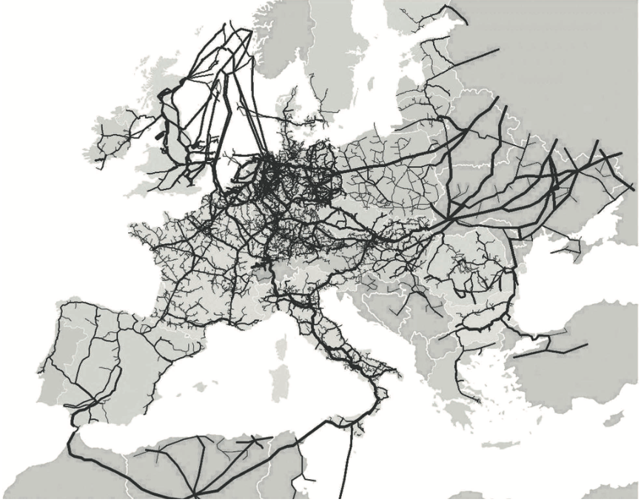
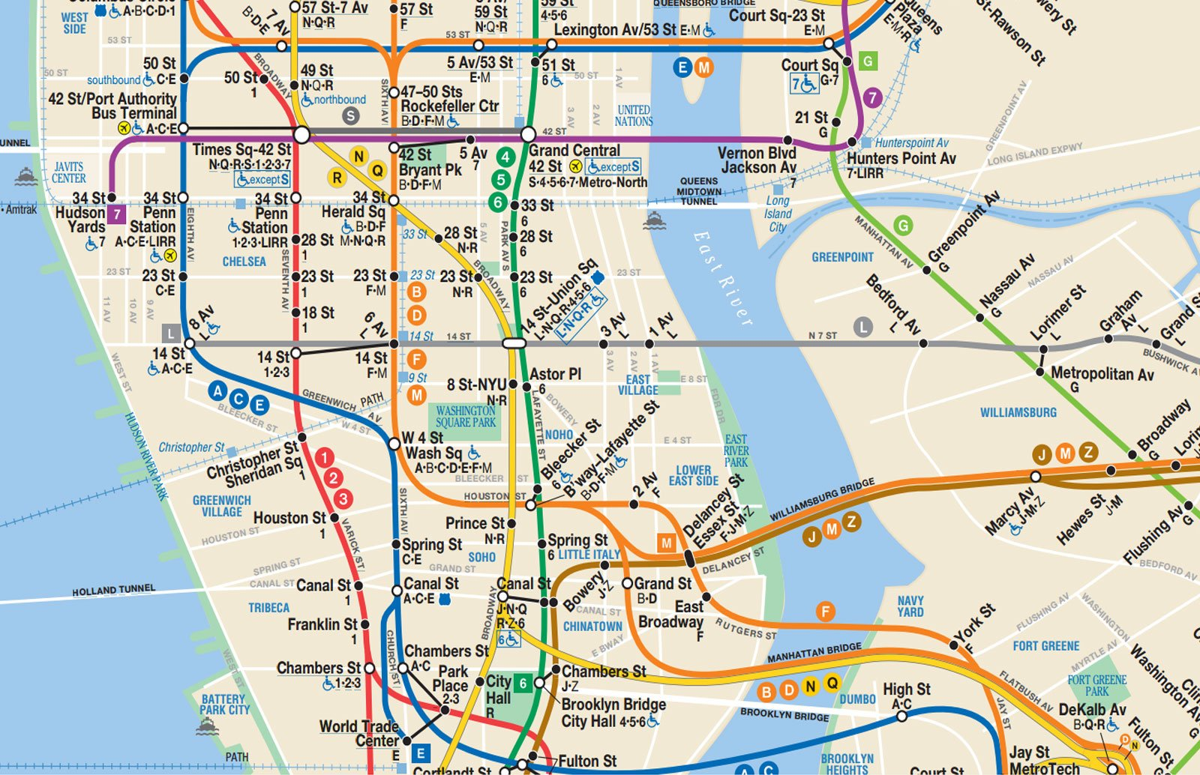
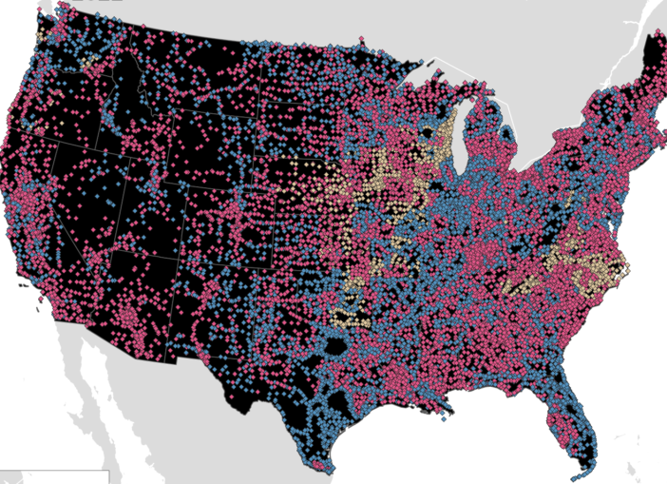
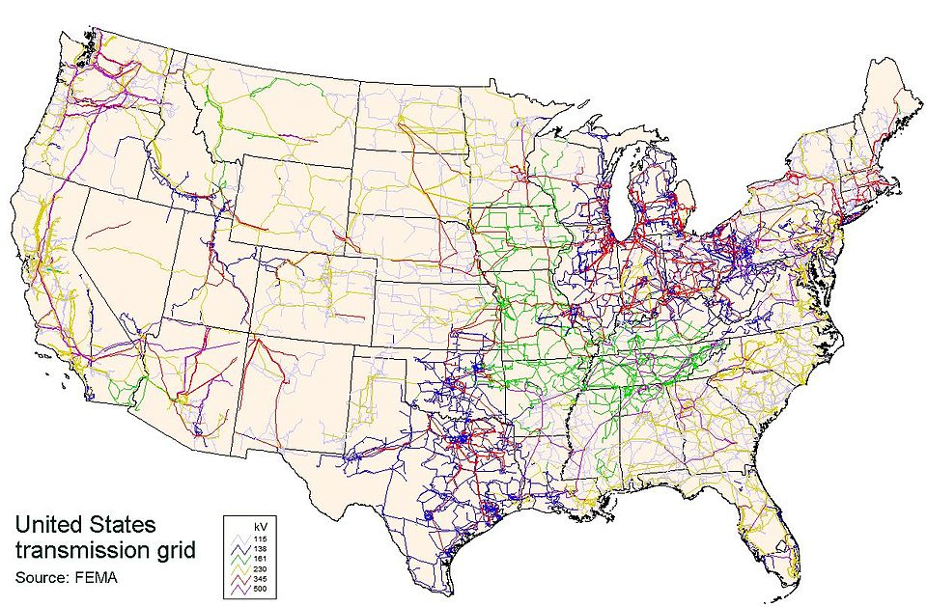
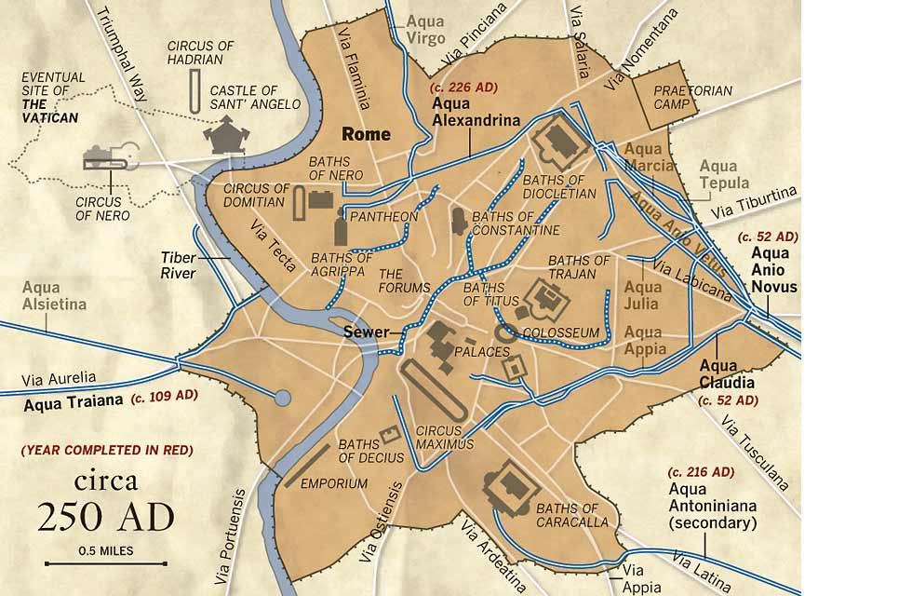
Technological Networks as Graphs
A. Computer Networks
B. Gas Pipelines
C. Transportation
Image credit: Newman 2018
Image credit: Newman 2018
Image credit: Go!NewYork
D. Communication Networks
E. Power Grid
F. Water Distribution
Image credit: soundingmaps
Image credit: wikimedia commons
Image credit: Los Angeles Times
Notes:
The network structure of the Internet based on class C subnets (groups of computers with similar IP addresses).
Natural gas pipelines in Europe.
NYC subway stations and routes
Cell towers – edges are between towers that handle call hand over
Power grid – nodes are powerplants and substations, edges are high voltage lines
Roman aqueducts circa 250 AD. Nodes are lakes / basins an cities with castella aquae (distribution tanks) and edges are the aqueducts themselves

Slide 17

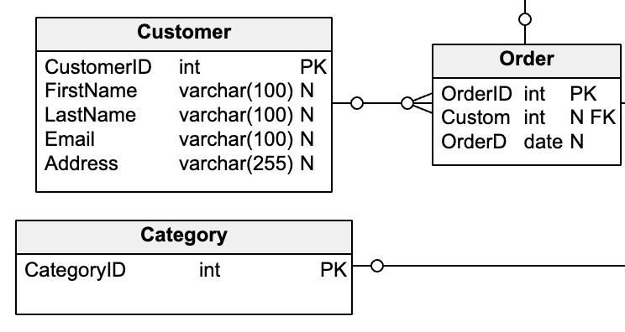
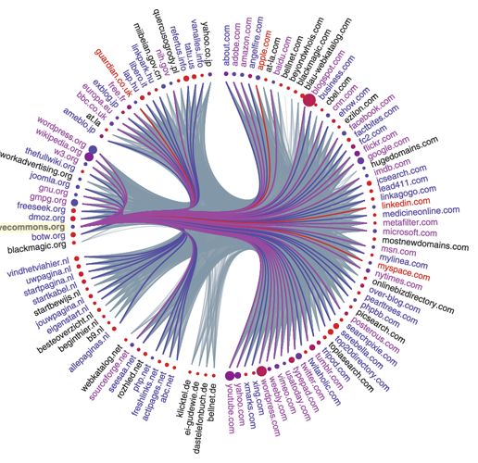




Information Networks as Graphs
B. Citation Network
C. Databases
A. World Wide Web
Image credit: vertabelo
D. Recommender Network
E. Keyword Index
computer
data
Image credit: American Scientist
silicon
Notes:
World wide web pages form a directional graph where nodes are web pages and edges are links from a source to destination page
Citation network where papers are nodes and directed edges go from paper A to paper B if A cites B
Databases can be viewed as graphs where tables (or individual rows) are nodes where edges indicate a key that connects the tables (or rows)
Recommender network is a bipartite graph where nodes are people and products where edges connect people to the product they recommend
Keyword index is a bipartite graph where words and pages are nodes and edges connect words to the pages on which they are used

Slide 18
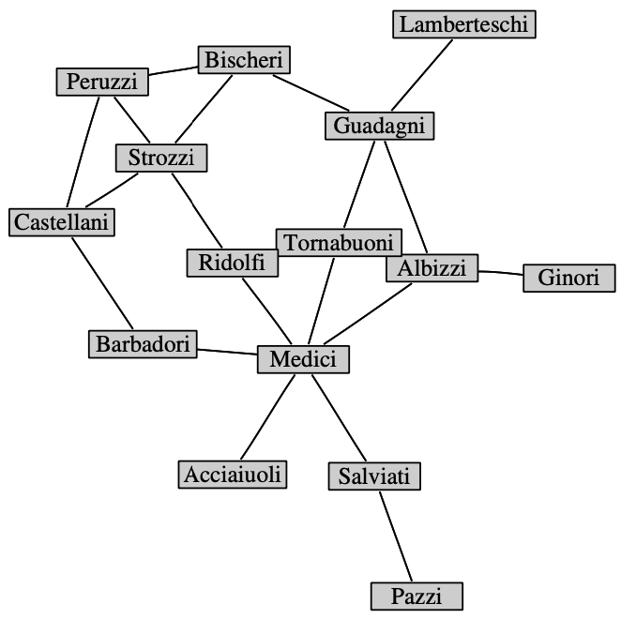
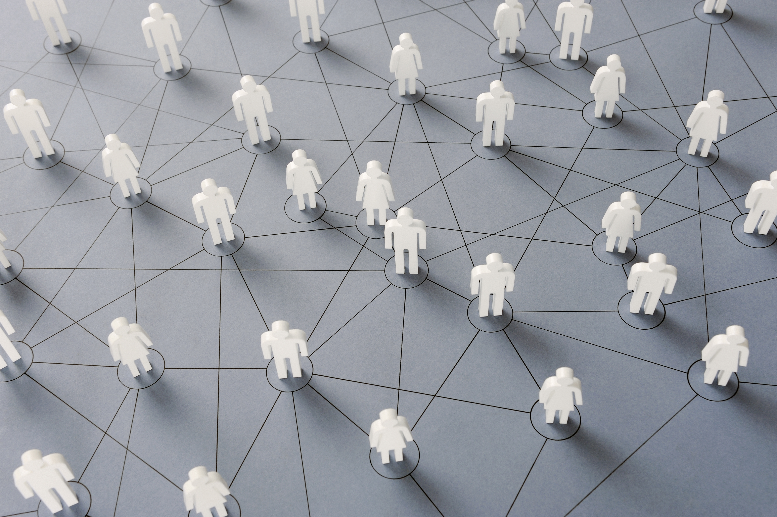

Social Networks as Graphs
A. Marriage Network
B. Social Media Networks
Image credit: Newman 2018
Notes:
A. Intermarriage network of ruling families of 15th century Florence.
B. Social media networks

Slide 19
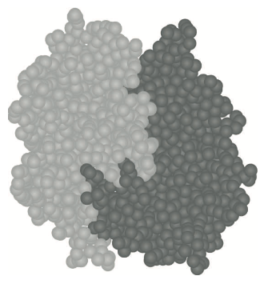
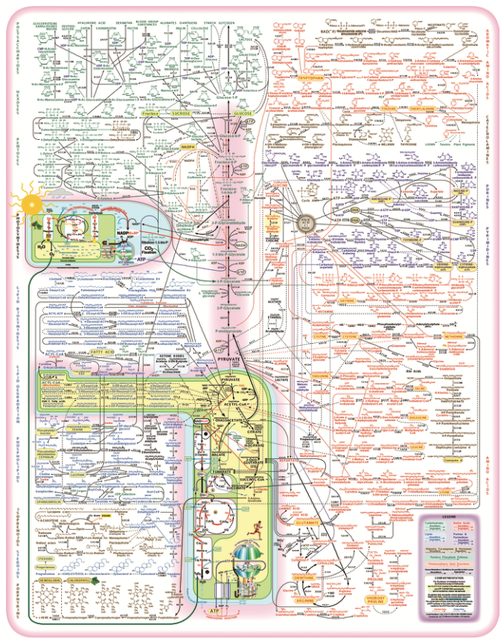
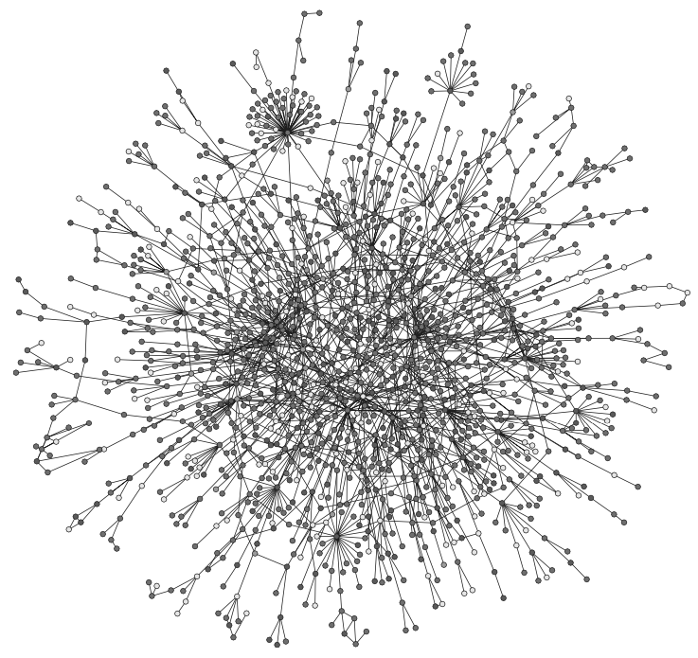
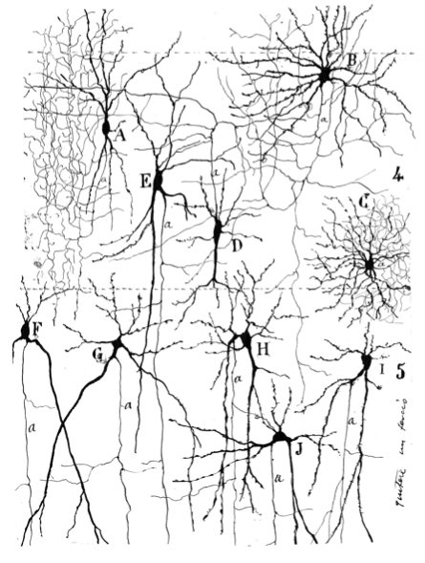
Biological Networks as Graphs
A. Metabolic Pathways
A. Protein Interactions
A. Neurons
Image credit: Newman 2018
Image credit: Newman 2018
Image credit: Newman 2018
Notes:
Network of major metabolic pathways
Protein-protein interaction network for Saccharomyces cerevisiae (baker’s yeast). Proteins physically combine to form complexes. A protein-protein interaction network indicates which proteins physically interact.
A collection of brain neurons hand-drawn by Ramón y Cajal.

Slide 20
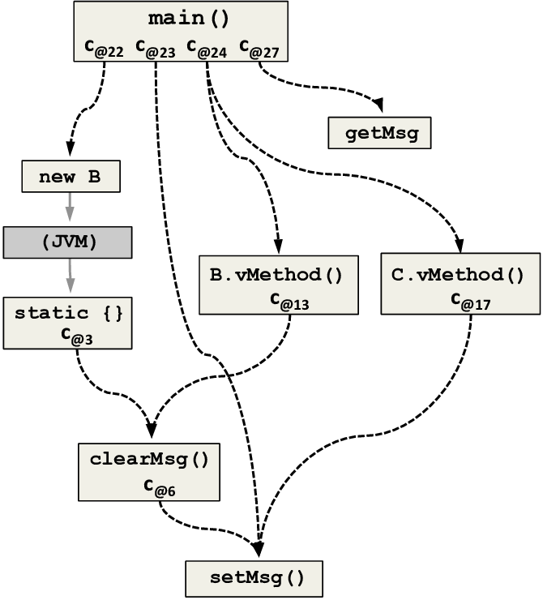
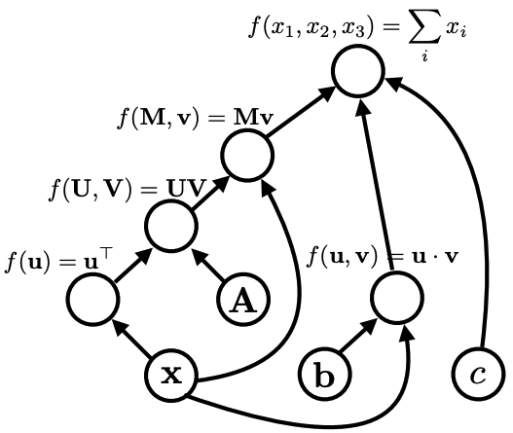
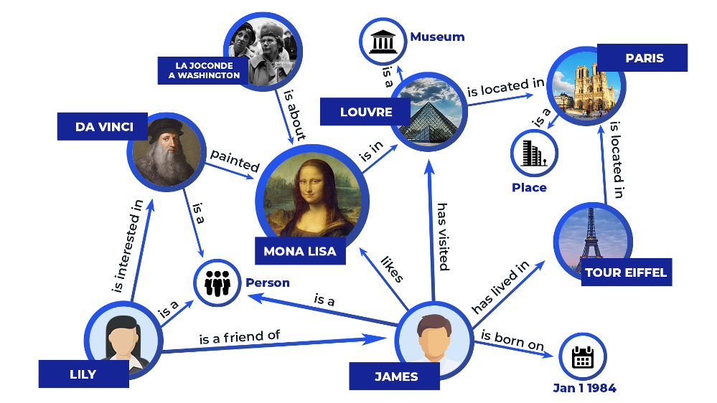
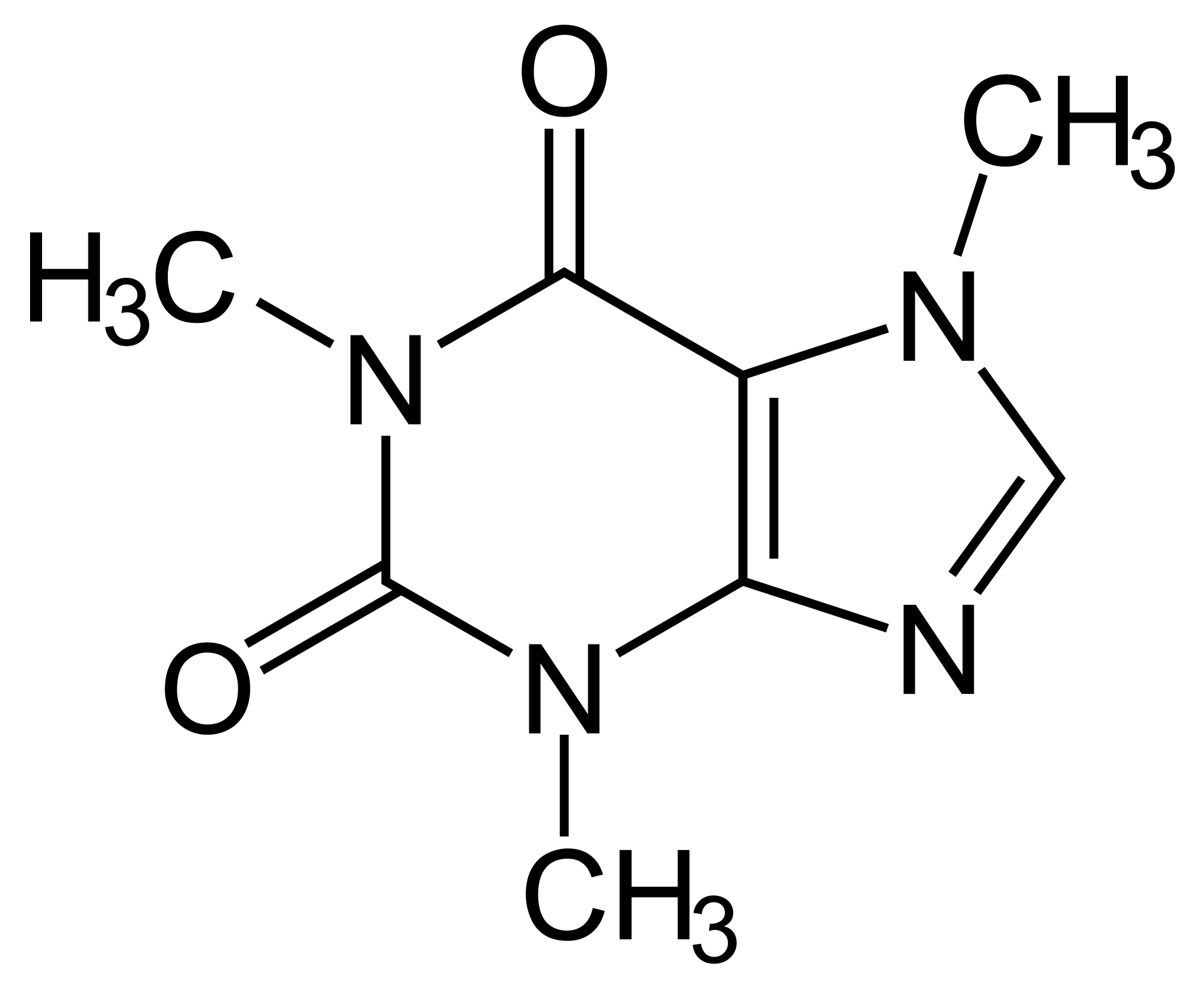
Other Graphs
A. Software execution
B. Computation
Image credit: Cornell University
D. Knowledge graphs
Image credit: ResearchGate
C. Molecules
Image credit: Chemistry StackExchange
Image credit: Zilliz
Notes:
Software execution as a graph. Nodes indicate methods with edges connecting methods that call a method
Computation graph where nodes are variables (scalars, vectors, etc) and edges are operations
Molecules where nodes are atoms and edges are bonds
Knowledge graph a generalized information graph where nodes are entities of interest and edges indicate relationships. Generally multiple types of nodes and relationships.

Slide 21
Rationale for specialized methods

Slide 22
Standard machine learning assumptions are violated
Independence
Standard machine learning assumes samples are statistically independent
Nodes in a graph are not usually independent. Knowing something about a node typically provides information about its neighbor nodes
Identically distributed
Standard machine learning assumes samples with the same features have the same label probability distribution
Nodes in a graph may have the same features but different label probability distributions when conditioned on their neighbors

Slide 23
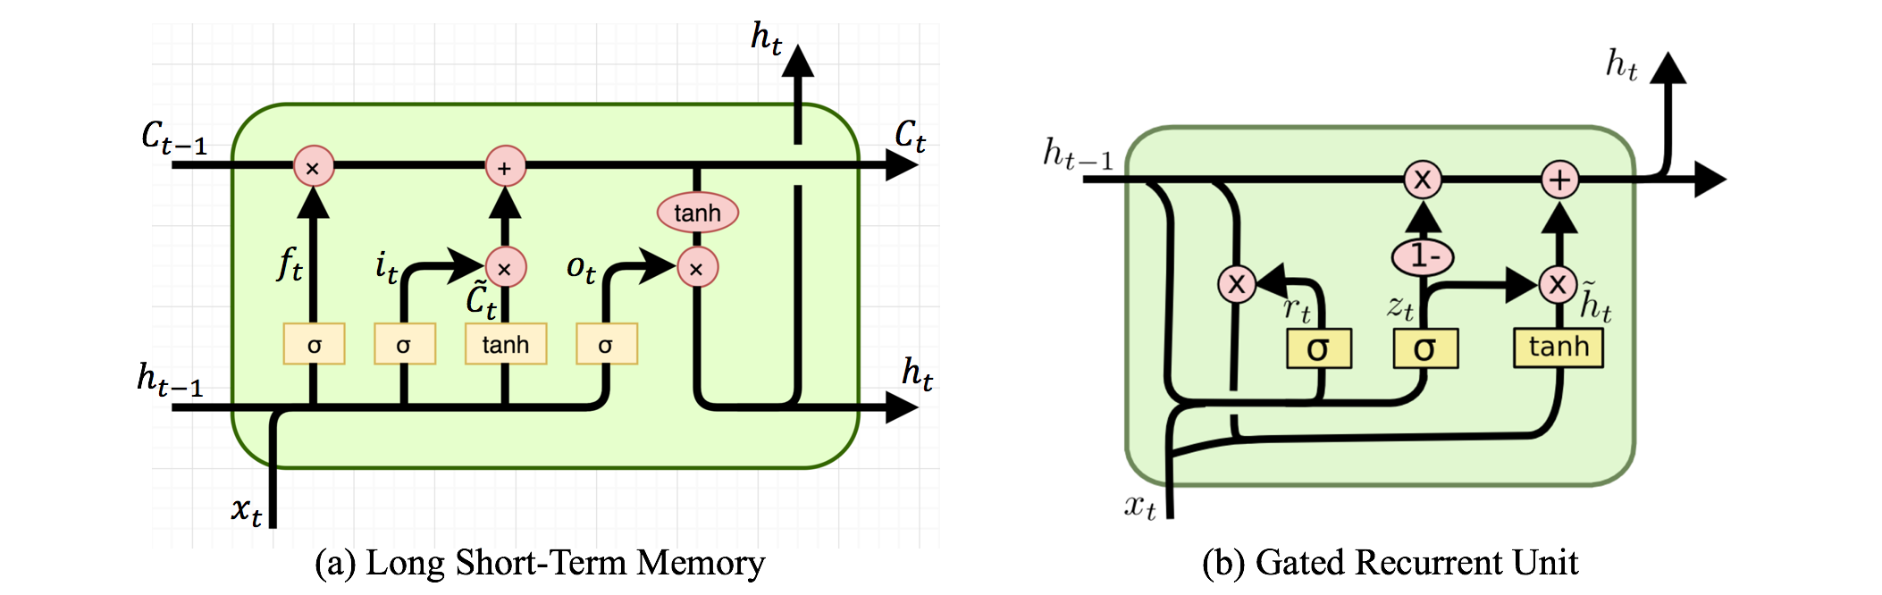
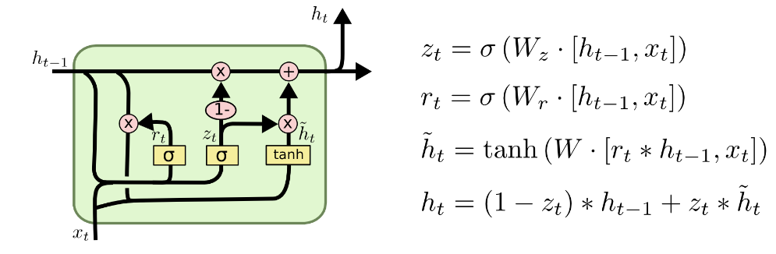
Modern ML toolbox assumes regularity
Standard ML methods and deep learning assume fixed-sized and ordered inputs

Slide 24
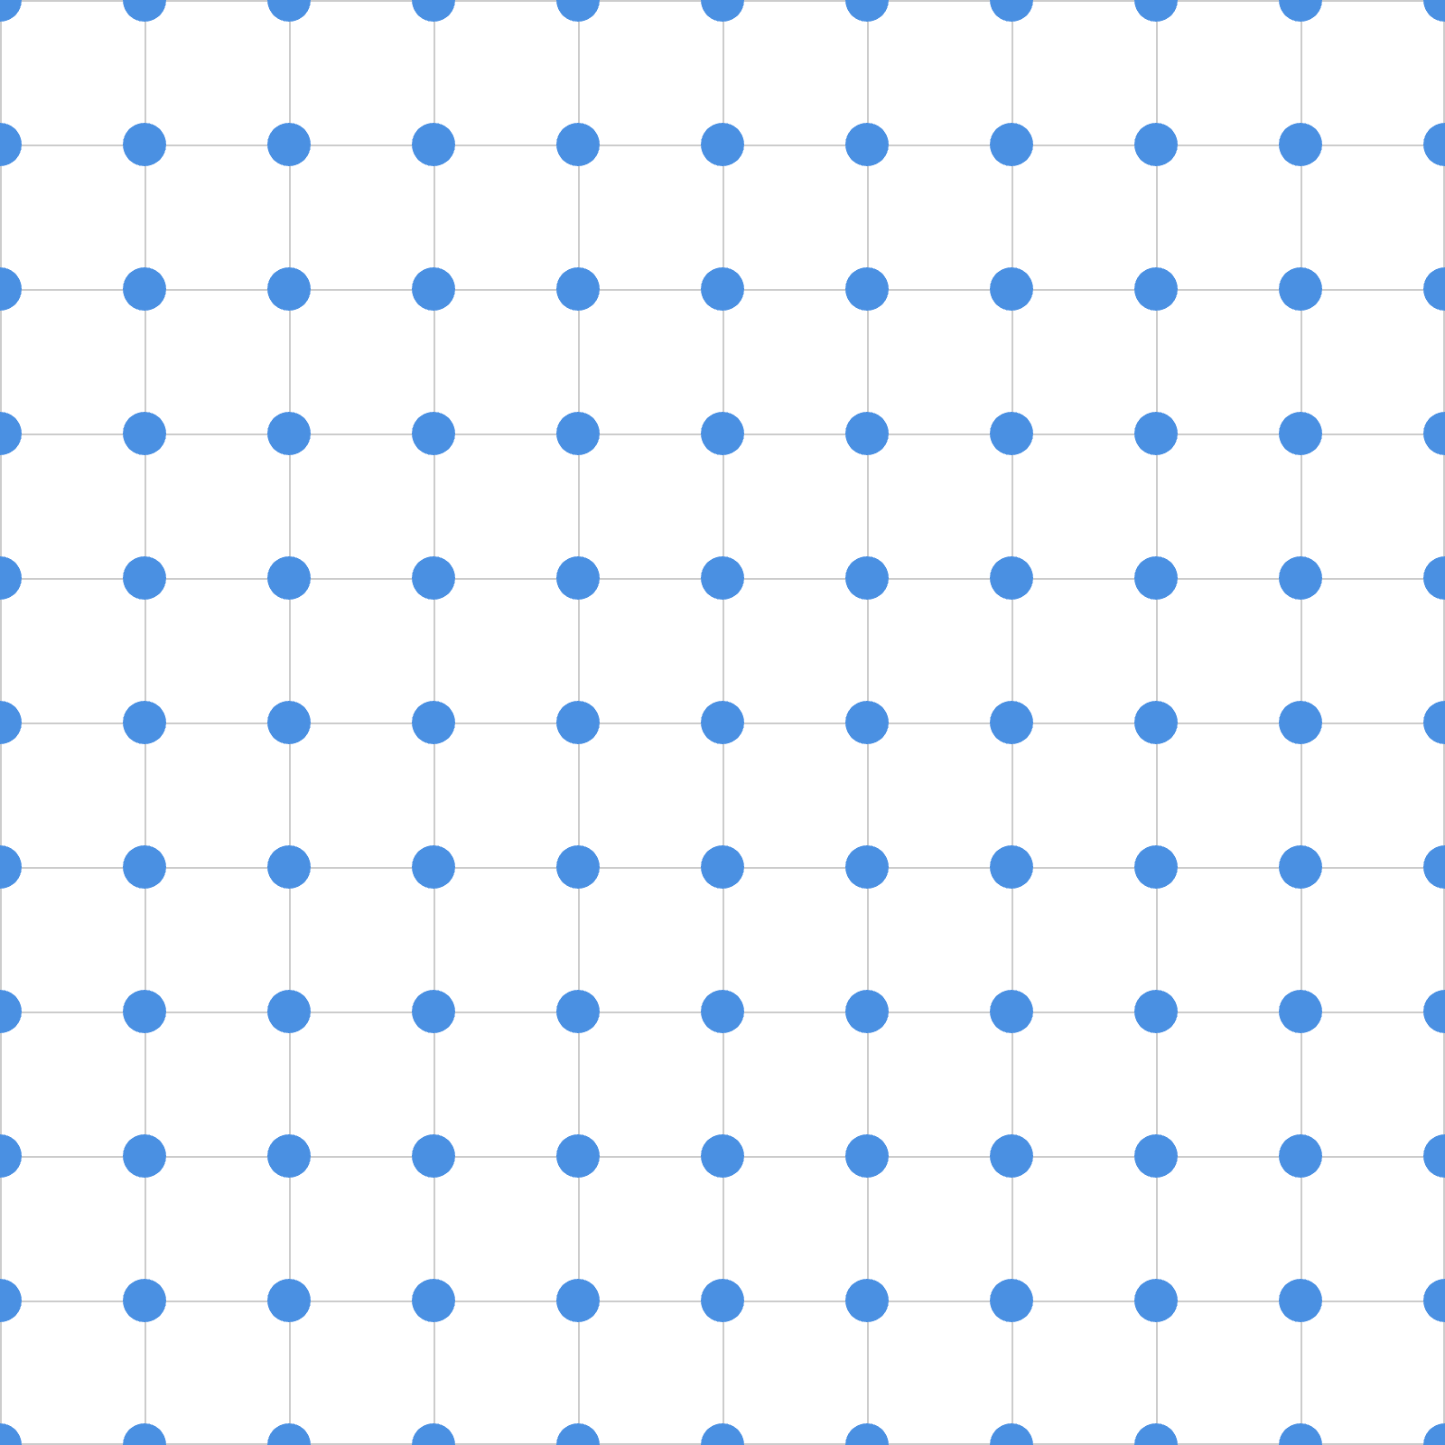
Modern ML toolbox assumes regularity
Graphs contain arbitrary node and edge counts
Graph nodes do not have an objective ordering
Different node types may have different features
VS
Graph Data
Images
Text

Slide 25
Graph learning is a hot topic
Top 25 keywords ICLR 2024

Slide 26
Terminology

Slide 27
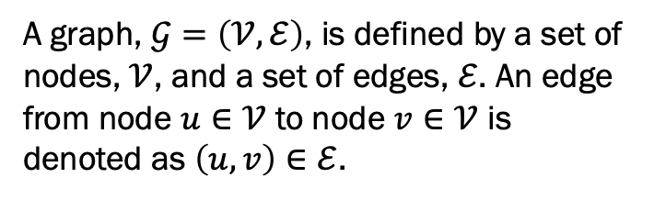
What is a graph?
A graph, $𝒢=\left(𝒱,ℰ\right)$, is defined by a set of nodes, $𝒱$, and a set of edges, $ℰ$. An edge from node $u∈𝒱$ to node $v∈𝒱$ is denoted as $\left(u, v\right)∈ℰ$.
Nodes (vertices) usually represent entities of interest
Edges usually represent relationships between nodes.
Graph representations may also include attributes (vertex / edge properties, e.g., text description).
Why not just represent these as additional vertices?
Tends to lead to very dense networks for properties that are common to most nodes.
Such properties usually don’t describe relations between nodes
Computational efficiency

Slide 28
Graph directionality
Undirected Graph – edges have no direction and define relations that are inherently bidirectional.
Directed Graph – edges have a specified direction and define relations that are inherently unidirectional.
Directed graphs may contain edges in both directions between nodes.

Slide 29
Acyclic graphs
A cycle is a closed loop of edges in a directed graph where the edges point in the same direction
Directed acyclic graph (DAG) - a directed graph without any cycles
Example: citation network where papers can only cite previously published papers
Not a cycle – arrows are not all in the same direction
Cycle: closed loop with arrows in same direction

Slide 30


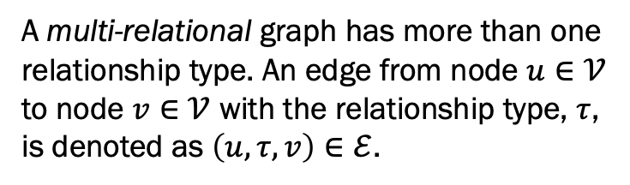
Multi-relational graphs
A multi-relational graph has more than one relationship type. An edge from node $u∈𝒱$ to node $v∈𝒱$ with the relationship type, $τ$, is denoted as $\left(u,τ,v\right)∈ℰ$.
friends
siblings

Slide 31
Heterogeneous graphs
Homogeneous graph– all nodes are of the same type and have the same attributes
Heterogeneous graph– different node types with possibly different attributes. Such nodes can be partitioned into disjoint sets.

Slide 32
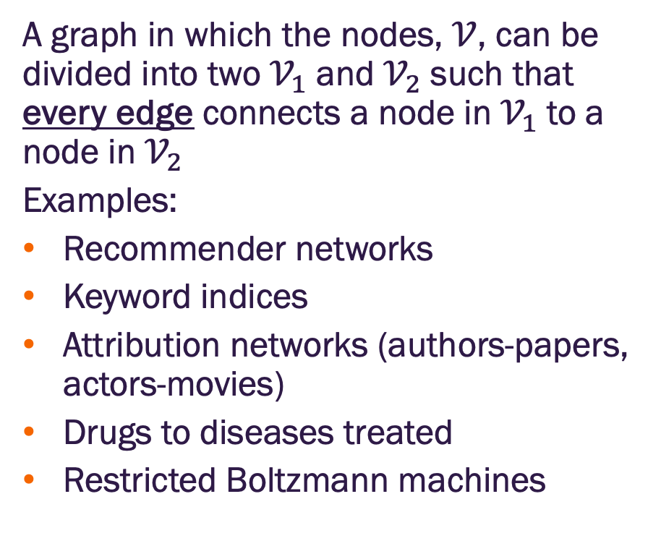
Bipartite graph
A graph in which the nodes, $𝒱$, can be divided into two $𝒱_{1}$ and $𝒱_{2}$ such that every edge connects a node in $𝒱_{1}$ to a node in $𝒱_{2}$
Examples:
Recommender networks
Keyword indices
Attribution networks (authors-papers, actors-movies)
Drugs to diseases treated
Restricted Boltzmann machines
All edges in a bipartite graph are between nodes of two distinct types.

Slide 33
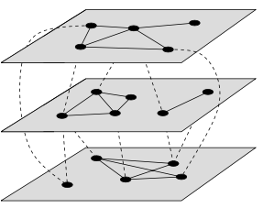
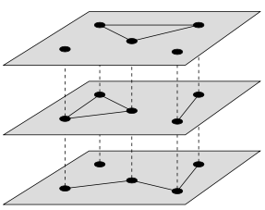
Multilayer and multiplex networks
Multilayer network
Multilayer networks contain a set of layers
Each layer is a distinct network with different node types and connectivity
Interlayer edges connect nodes between layers
Example: transportation network where layers represent airlines, trains, and buses where interlayer connections indicate shared location.
Multiplex networks
Special case of multilayer network where the nodes are the same but connectivity changes
Example: social network with different relationship types at each layer
Dynamic networks
Nodes & connections change over time →multilayer
Only connections change over time →multiplex
Multiplex network
Image credit: Newman 2018

Slide 34
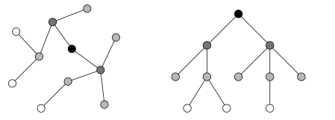
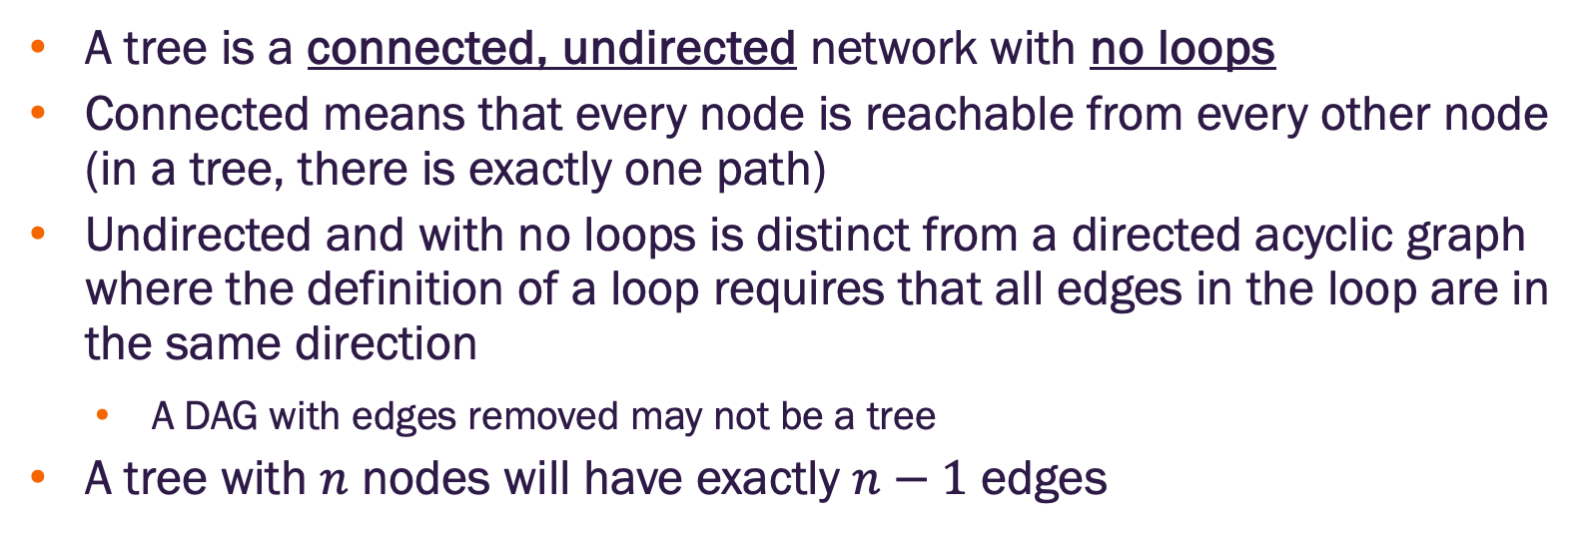
Trees
A tree is a connected, undirected network with no loops
Connected means that every node is reachable from every other node (in a tree, there is exactly one path)
Undirected and with no loops is distinct from a directed acyclic graph where the definition of a loop requires that all edges in the loop are in the same direction
A DAG with edges removed may not be a tree
A tree with $n$ nodes will have exactly $n−1$ edges
Image credit: Newman 2018

Slide 35
Graph or network?
Network – the real-world system or phenomena of interest
Graph – a model of the network
Network
Graph (model)

Slide 36
Machine learning tasks on graphs

Slide 37
Intra-graph machine learning tasks
Node classification – given information about the node (may include neighbors, relationships, attributes), infer class membership (usually an attribute)
Edge prediction – given information about two nodes, determine if a given relation exists between them
Community detection (node clustering) – detection of “meaningful” node groups
Community Detection
Edge Prediction
?
A
B
Node Classification

Slide 38
Whole graph and inter-graph machine learning tasks
Whole graph classification and regression – given one entire graph, infer class membership or estimate (regress) a related numerical property
Inter graph tasks – given multiple graphs estimate the similarity between graphs and/or identify clusters
Classification
A
B
Regression
Y
G₁
G₂
Clustering
C₁ = {G₁, G₃, G₄}
C₂ = {G₂}
G₃
G₄

Slide 39
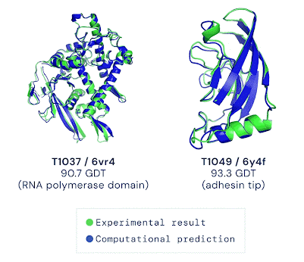
AlphaFold
Proteins represented as graphs
Nodes: amino acids of protein
Edges: proximity between amino acids
Goal: predict the 3D spatial coordinates of each amino acid (node) from input protein sequence
Image credit: Deepmind

Slide 40



PinSage: Graph based recommendation
Model Pinterest as a bipartite graph of “pins” and “board” nodes. Pins are associated with text and image features.
Goal is to recommend “pins” (on Pinterest)
View recommendations as link predictions between pins and boards
Graph model used to form embeddings of pins that serve as ”queries” for pin recommendation
Poor
recommendation
Good
recommendation
Ying, Rex, et al. "Graph convolutional neural networks for web-scale recommender systems."
Proceedings of the 24th ACM SIGKDD international conference on knowledge discovery & data mining. 2018.

Slide 41
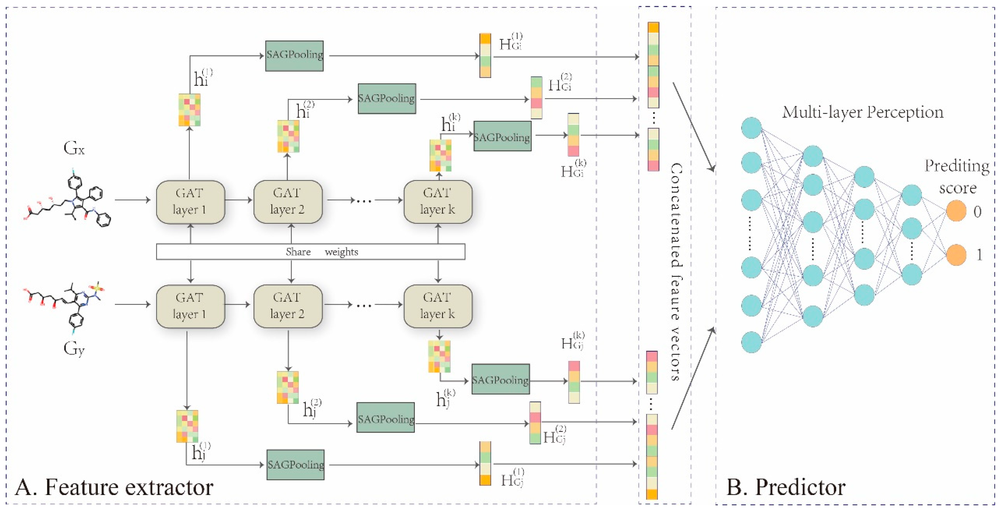
Drug-drug interaction prediction
Each drug is represented by a graph
Each drug in a candidate DDI pair is passed through a 5-layer GCN with attention
Node representations are down-sampled to form a representation of each drug
Graph classification: drug representations are concatenated and passed through a FFN for DDI classification
Feng, Y.-H.; Zhang, S.-W. Prediction of Drug-Drug Interaction Using an Attention-Based Graph Neural Network on Drug Molecular Graphs. Molecules 2022, 27, 3004

